Slide 1
Creative writing stimuli

Slide 2
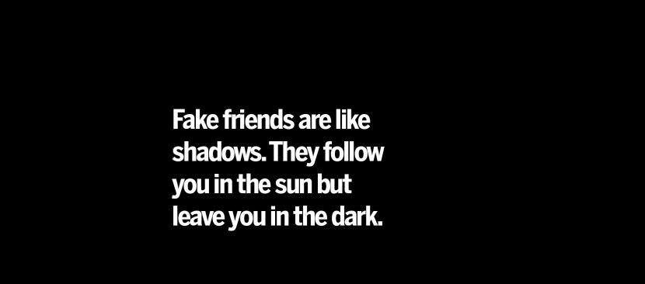
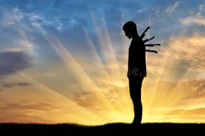
McDonald betrays Scotland

Slide 3
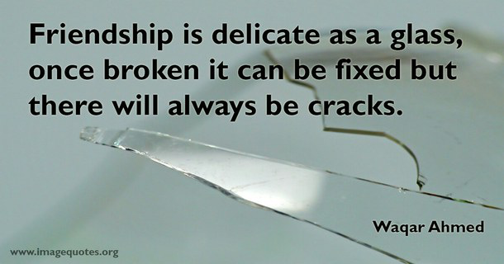

Slide 4

Instruments of darkness win us with honest trifles, to betray’s in deepest consequence

