Slide 1
Homophones homo = the same phone = sound
Which their/there/they’re is it? Find the 5 errors
‘There is no need to worry about me’, explained Johnny, ‘I’m the king of the world.’ Slowly but surely however, Johnny began to realise that they’re was no way he could keep treading water for much longer.
‘Try to swim over there’, his girlfriend implored. They’re eyes met and they both knew it was hopeless. Their was no way he could swim for that distance, and their was no way of getting him back into the boat – it was too full. Johnny looked into her eyes for the last time before his head dipped under the water and he took on a large gulp of water. As he sunk, he only had one thought on his mind: they’re love would never die.

Slide 2
Spelling
Sodden = drenched, soaked
Slanting = on a slope
Condemned = to judge with disapproval, to be guilty
Deprecate = to express disapproval, belittle
Disparage = belittle
Denigrate = criticise in a nasty way
Revile = to speak about someone with abusive tone
Defame
Asperity = harshness
Acrimonious = harsh and bitter

Slide 3
Consider these ideas: - word choice that emphasizes the scene - imagery of the cells
It was in Burma, a sodden morning of the rains. A sickly light, like yellow tinfoil, was slanting over the high walls into the jail yard. We were waiting outside the condemned cells, a row of sheds fronted with double bars, like small animal cages. Each cell measured about ten feet by ten and was quite bare within except for a plank bed and a pot of drinking water. In some of them brown silent men were squatting at the inner bars, with their blankets draped round them. These were the condemned men, due to be hanged within the next week or two.
How has the writer created an oppressive mood in this beginning to a story? Write 80 words

Slide 4
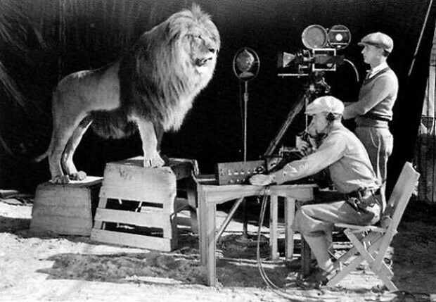
Moments later…….
Complete the story. Consider things like how long the lion has been caged, captured, or looked after etc. before this moment. 300-400 words

