Slide 1
General language building 6

Slide 2
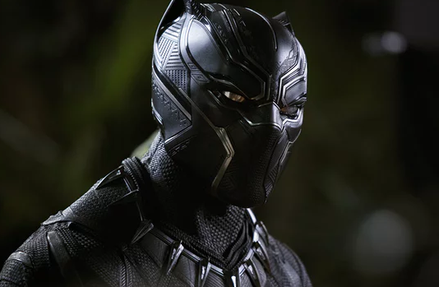
Having already, impressed, with it’s £10.5m UK opening, plus previews, Black Panther. signals its likelihood for sustained success with second weekend takings of £6.86m – a relatively slim 35% decline from the opening; session. After 13 days, the Marvel film has notched up £29.5m?
Remove the unnecessary punctuation marks. Write out in full.

Slide 3
Having already, impressed, with it’s £10.5m UK opening, plus previews, Black Panther. signals its likelihood for sustained success with second weekend takings of £6.86m – a relatively slim 35% decline from the opening; session. After 13 days, the Marvel film has notched up £29.5m?
Remove the unnecessary punctuation marks. Write out in full.

Slide 4
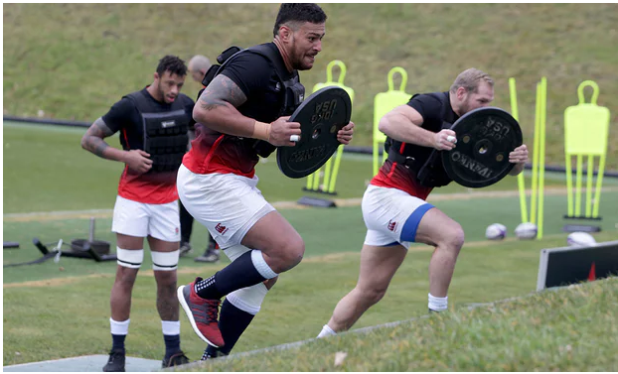
eddie jones has a vivid recollection of the buildup to his first game as england coach against scotland in edinburgh. two years on, before saturday’s calcutta cup reunion, he has been replaying the video footage to his squad this week and says it still sends a shiver down his spine. “after the first training run I was thinking: ‘goodness me, what have I got myself into here? after 20 minutes they were just shot. they couldn’t run any more.”
Write out the words that should have capital letters.

Slide 5
Eddie Jones has a vivid recollection of the buildup to his first game as England coach against Scotland in Edinburgh. Two years on, before Saturday’s Calcutta Cup reunion, he has been replaying the video footage to his squad this week and says it still sends a shiver down his spine. “After the first training run I was thinking: ‘Goodness me, what have I got myself into here? After 20 minutes they were just shot. They couldn’t run any more.”
Write out the words that should have capital letters.

Slide 6
Spelling test
Loving | Temerity | Implies
Irresponsible | Fractured | Conveys
Hopeful | Doubtful | Highlights
Virtuous | Disappointing | Contrasts
Notes:
Spelling first, then Definitions – temerity = reckless boldness

Slide 7
Oral comprehension
Listen to the video.
How does Barack Obama present his father in How I am
still haunted by my father?
Video >> Father’s Day Speech

Slide 8
Oral comprehension
Listen to the video.
How does Barack Obama present his father in How I am
still haunted by my father?
Loving | Temerity | Implies
Irresponsible | Fractured | Conveys
Hopeful | Doubtful | Highlights
Virtuous | Disappointing | Contrasts
Video >> Father’s Day Speech
Notes:
Play video again, and take notes of quotes. Then use the vocab to analyse the speech. 7 minute task – get as many examples covered as possible. Does he use any language techniques?

Slide 9
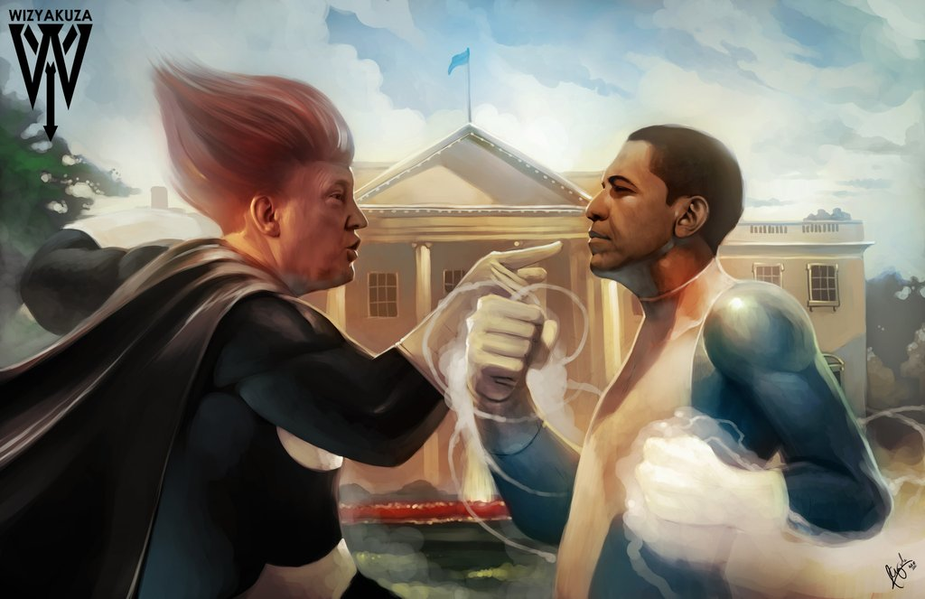
Writing – Write a story based on the image. Use vocab. 20 mins = 200 words
Menacing | Formidable
Irresponsible | Fractured
Virtuous | Doubtful
Confused | Disappointing
Destructive | Inexorable
Arrogant | Temerity

