Slide 1
Language building 13

Slide 2
PUNCTUATION
THESE PARAGRAPHS ARE MISSING 7 FULL STOPS EACH. Fill them in. Read it out loud to see if it makes sense.
John felt a bit sick when he thought about all those squashed animals John couldn’t remember anything about squashed bones in the glamorous advert in the supermarket they even had a famous athlete eating them John decided to ask some questions about how the bones were squashed his research on the internet found some pretty horrible facts about how the animals were treated he was starting to have second thoughts about sausage rolls John’s friends just laughed at him
Suddenly Steve realised that Hayley was getting closer could it be deliberate either way he was glad it was happening she looked even more beautiful than normal tonight, and he realised that he really really liked her he took a deep breath, thought about what could possibly go wrong even if she said no, and decided to take the plunge he made a direct line for her, but just as he was about to say hi, Johnny Wells, from Oketown High, tapped her on her shoulder Steve froze on the spot not again he thought

Slide 3
Spelling
Key vocab
Conscientious = being morally aware
Dopamine = chemical that provides joy
Validation = proved worthy
Exploiting = taking advantage of
Vulnerability = easily wounded or hurt
Recollections = memories
Optimize = creating the best conditions
Disillusionment = reduced hope
Discourse = conversation
Articulate = express in words
Ostensibly = apparently
Benevolent = good
Disingenuous = lacking truth or quality

Slide 4
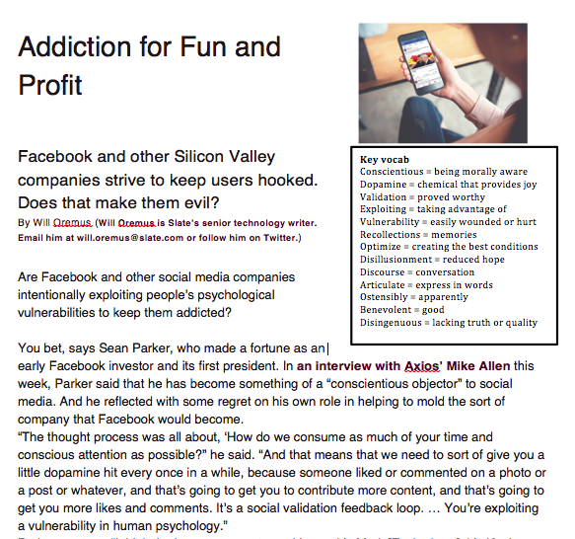
Comprehension

Slide 5
Transactional writing
Design and create a leaflet assisting young people to be aware of the traps of social media.
Your leaflet should contain a catchy title, at least 3 headings, a polemic argument, and at least 300 words of information.

