Slide 1
Language Building 12

Slide 2
Developing interesting sentences.
Adding extra information to a sentence is crucial to improve the depth and quality of your writing. The extra information is usually not needed to make a sentence complete, but adds description and detail.
For example: The sun setting behind the sandstone mountains, Clara began to shiver as the temperature rapidly decreased.
The underlined section is extra info that doesn’t have to be in there, but it certainly improves our ability to picture the scene.

Slide 3
1st sentence: add I new idea
2nd sentence: add 2 new ideas
3rd sentence: add 3 new ideas
4th sentence: add 4 new ideas
Using the example below, add more information to the sentences – not just one word
Jane went walking.
The sun was setting slowly.
The day began unlike any other.
The teacher yelled at the class.

Slide 4
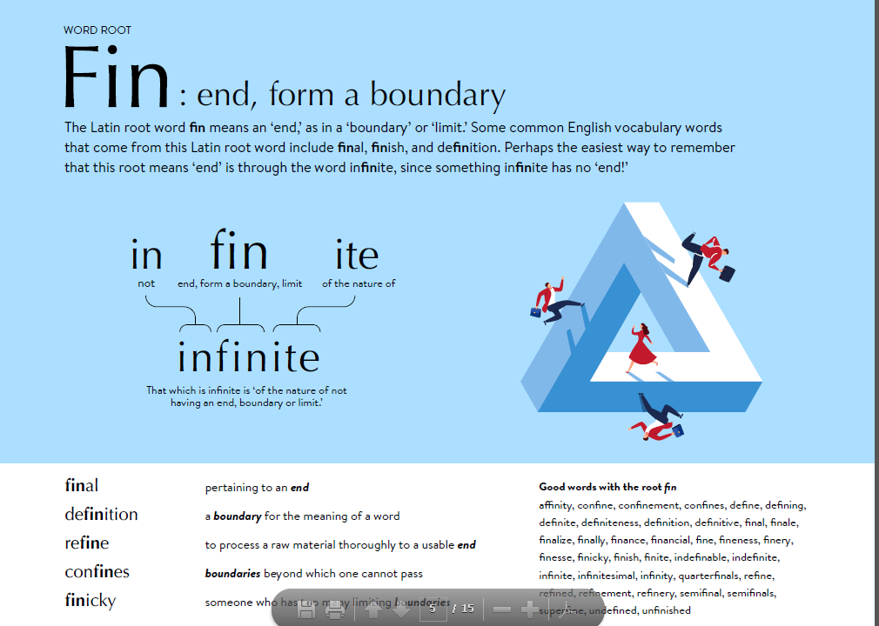

Slide 5
Spelling
Infinite
Definite
Definitely
Affinity
Confined
Remembered
Squawked
Delightedly
Finale
Transfixed

Slide 6
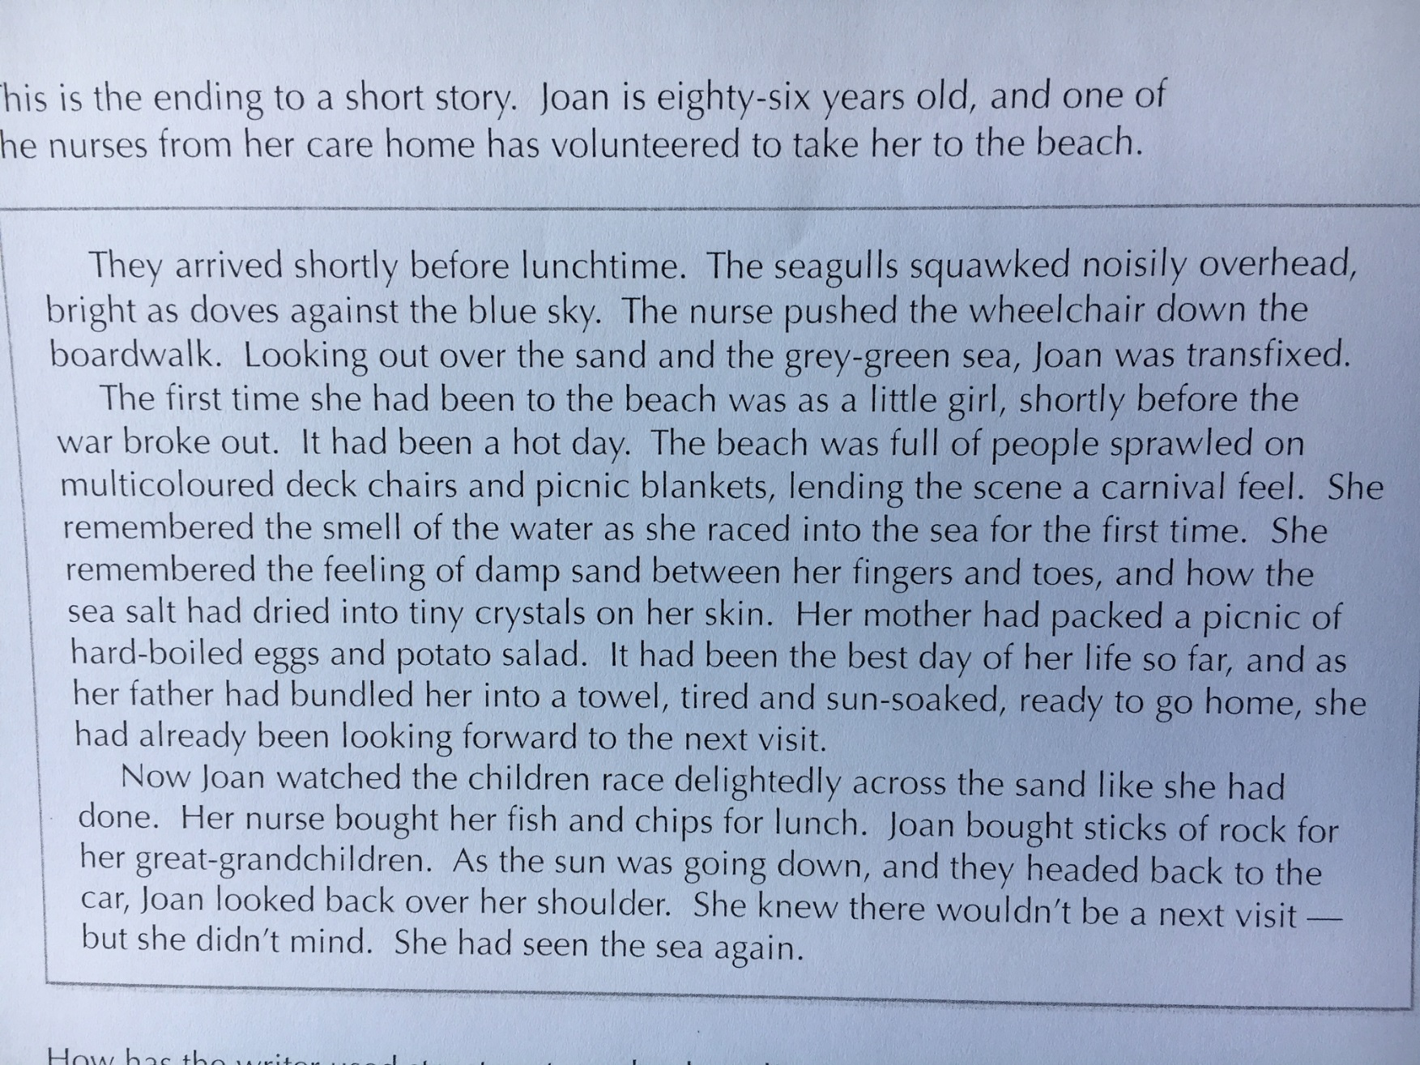
How has the writer created a sense of sympathy for Joan?
- consider: the use of flashback; contrast; sentence lengths

Slide 7
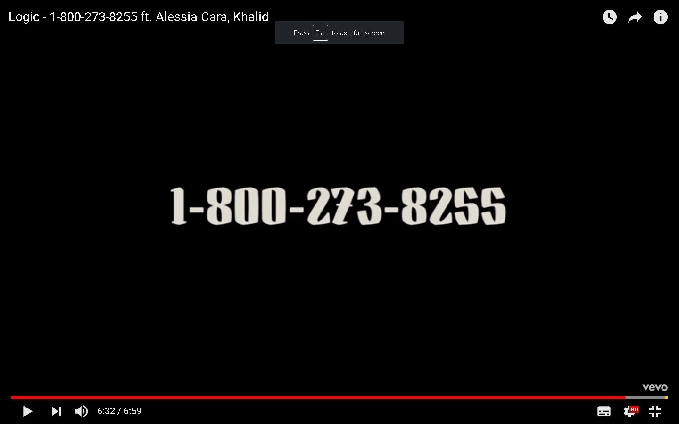
Create a leaflet to help young people who are having a difficult time with their sexuality.

Slide 8
How to create a leaflet

Slide 9
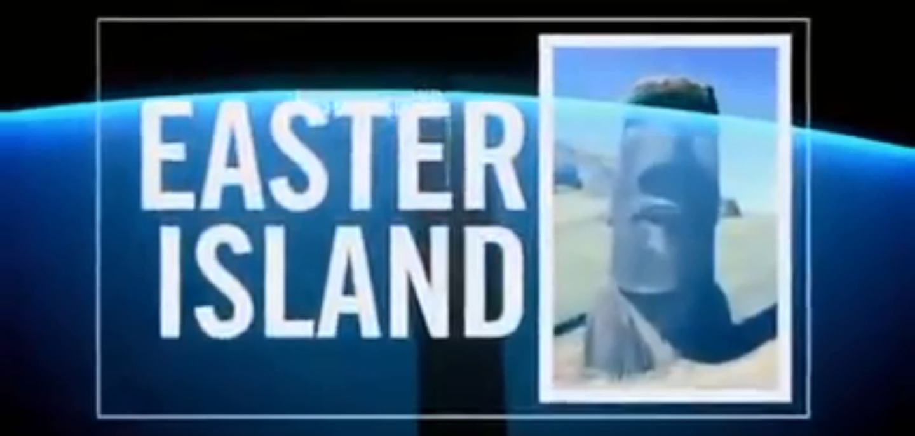
Watch the video.
You are an astronomy student. You do some more investigations into these ideas, and after reading and deciphering an ancient manuscript, you keep coming across the code FIN 2019. No one has ever thought of deciphering the code the way you have.
What do you do?
Write a short story describing the next scene.

