Slide 1
Language building 4

Slide 2
Homophones homo = same phones = sound
Some students struggle with these homophones: weather (the conditioning of the air), whether (a connective introducing an alternative)
Identify the errors in this passage. There are 3.
I’m not sure weather the weather is going to be sunny today. It often depends on whether the sun is out or not. Whatever the whether, I think we should go out and see the concert.

Slide 3
Rearrange into the right order
Once all the flour is incorporated, beat until you have a smooth, thick paste.
Crack the eggs into the middle, then pour in about 50ml milk and 1 tbsp oil.
Put the flour and a pinch of salt into a large mixing bowl and make a well in the centre.
Start whisking from the centre, gradually drawing the flour into the eggs, milk and oil.

Slide 4
Rearrange into the right order
It definitely takes some practice, since most of us are in the habit of taking quick, shallow breaths instead of long, deep ones.
Let the air completely fill your lungs.
Deep breathing will help you be more mindful of your body. Feel the air enter your lungs and fill them up. When you're concentrating on taking a deep breath, your worries are pushed aside for the time being.
Take a slow, deep breath in through your nose.
Focus on breathing in as much as you can through your nose, which has tiny hairs that filter out dust and toxins so they can't reach your lungs.^{[1]}

Slide 5
Past tense
Most times, when you discuss an action that happened in the past, you simply add ‘ed’ to the word. But there are some exceptions.
Which of the words below are in the past tense?
Jumped
Stretched
Missed
Mist
Went
Hazard
Jeopardized
Ostracized
Legitimate
Travel

Slide 6
Key vocab for the next text
Tragedy = a terrible unexpected event
Proposed = suggested
Induced = persuaded
Regiment = part of an army
Testify = support, back-up
Insensible = out of his mind
Providence = God
Assuredly = certainly
Bludgeon = bash repeatedly
Hypothermia = beyond cold
Oblivion = nothingness

Slide 7
1. How cold was it at midday? 2. What was the name of the man who was dying? 3. Who were the young man’s last thoughts of? 4. Highlight short sentences – how do these add to the tone of the text? (Write 1 PEE paragraph to explain.) 5. Find 4 words that create a dramatic tone. 6. How far do you agree that Scott creates a feeling of hopelessness towards the end of his diary entry? In other words, prove why you have your opinion by explaining quotes
Sunday, March 17th
Lost track of dates, but think the last correct. Tragedy all along the line. At lunch, the day before yesterday, poor Titus Oates said he couldn’t go on; he proposed we should leave him in his sleeping-bag. That we could not do, and induced him to come on, on the afternoon march. In spite of its awful nature for him he struggled on and we made a few miles. At night he was worse and we knew the end had come.
Should this be found I want these facts recorded. Oates’ last thoughts were of his Mother, but immediately before he took pride in thinking that his regiment would be pleased with the bold way in which he met his death. We can testify to his bravery. He has borne intense suffering for weeks without complaint, and to the very last was able and willing to discuss outside subjects. He did not – would not – give up hope to the very end. He was a brave soul. This was the end. He slept through the night before last, hoping not to wake; but he woke in the morning – yesterday. It was blowing a blizzard. He said, ‘I am just going outside and may be some time.’ He went out into the blizzard and we have not seen him since.
I take this opportunity of saying that we have stuck to our sick companions to the last. In case of Edgar Evans, when absolutely out of food and he lay insensible, the safety of the remainder seemed to demand his abandonment, but Providence mercifully removed him at this critical moment. He died a natural death, and we did not leave him till two hours after his death. We knew that poor Oates was walking to his death, but though we tried to dissuade him, we knew it was the act of a brave man and an English gentleman. We all hope to meet the end with a similar spirit, and assuredly the end is not far.
I can only write at lunch and then only occasionally. The cold is intense, -40º at midday. My companions are unendingly cheerful, but we are all on the verge of serious frostbites, and though we constantly talk of fetching through I don’t think anyone of us believes it in his heart.
R.Scott
Notes:
Students practice comprehension skills by answering questions based on the text. This is a strengthening exercise before we move onto exam style responses.

Slide 8
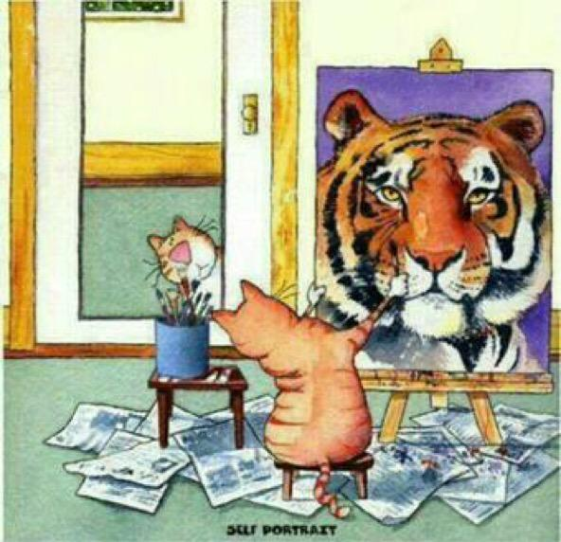
Write a letter to yourself to be read in 10 years from now. What do you want to achieve,, and how will you get there?

