Slide 1
Language building 10

Slide 2
Vladimir Putin cruised to victory in Sundays presidential elections in a result that was never in question His fourth term as pressident will extend until 2024, making him the first Kremlin leeder to serve to decades in power since Josef Stalin. With results still coming in, Putin looked set to exced expectations by clinching more than 75% of the vote
Punctuate the passage above and correct the misspelt words.

Slide 3
Vladimir Putin cruised to victory in Sunday’s presidential elections in a result that was never in question. His fourth term as president will extend until 2024, making him the first Kremlin leader to serve two decades in power since Josef Stalin. With results still coming in, Putin looked set to exceed expectations by clinching more than 75% of the vote.
Punctuate the passage above and correct the misspelt words.

Slide 4
Spelling
Optimism
Pessimism
Loneliness
Seclusion
Solitary
Forlorn
Despondent
Companionship
Acquaintance
Sensitivity
Subtle
Susceptible

Slide 5
How does the writer create a sense of sympathy for Bill?
Blind Bill’s day started like any other. He was a man who liked routine and on warm summer days he liked to spend his time in his garden. He shifted his position in his garden chair and checked his table top again for his mobile telephone. He would phone his son later, but not yet. Bill would only bother him in the really lonely times.
This morning he hoped there would be some visitors or a neighbour passing his gate who would stop and pass the time of day with him.
Some time later, Bill recognised Mrs Jobson’s heavy footsteps. It was a Wednesday, and Bill knew it was her day for Willbridge supermarket. “Nice drying day for your washing, Mrs Jobson.” His comment took her by surprise, and he heard her gasp. She would wonder how a blind man could know about her washing. Heavens, silly woman; the flapping, cracking sound it made as gust of wind came down the valley was loud enough. And he knew she always did her washing before going to the supermarket. He enjoyed teasing her.
“You’d better have it in by three, though. It’ll rain by three.”
Again he was rewarded by her gasp of surprise. But she believed him because he’d always been right before. He could feel the weather fronts coming as the wind changed to the west on his cheek, and he felt the slight pressure of warm dampness on his skin that confirmed the change of weather to come.
Consider:
Words that emphasise his loneliness
Contrast of his good qualities
Structure - how does the text develop?

Slide 6
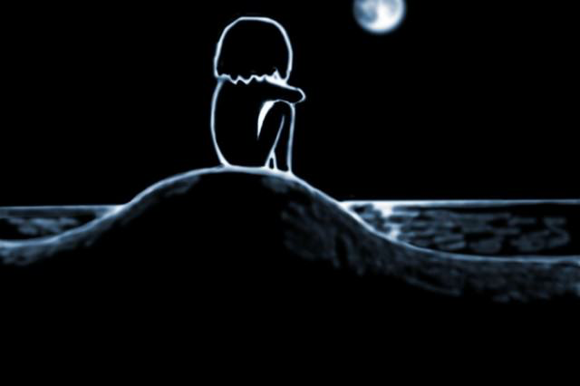
Create a leaflet helping people who may be feeling lonely
200 words = 20 minutes

