Slide 1
Language building 8

Slide 2
if you Missed this, the particulars are this: at a photo-call for the Film red sparrow, lawrence was photographed in a low-cut, thigh-slit dress, flanked by four male Actors. a lot of people commented that lawrence looked cold and that her male co-stars were all wrapped up warm. lawrence then responded, saying she was “extremely offended” and Wearing the “fabulous” dress was her choice.
Copy out the passage and add or remove the capital letters.

Slide 3
If you missed this, the particulars are this: at a photo-call for the film red sparrow, Lawrence was photographed in a low-cut, thigh-slit dress, flanked by four male actors. A lot of people commented that Lawrence looked cold and that her male co-stars were all wrapped up warm. Lawrence then responded, saying she was “extremely offended” and wearing the “fabulous” dress was her choice.
Copy out the passage and add or remove the capital letters.

Slide 4
Spelling
Government
Incentive
Provoke
Dissuade
Dismay
Nauseous
Indignation
Resentment
Perplexed
Barbaric

Slide 5
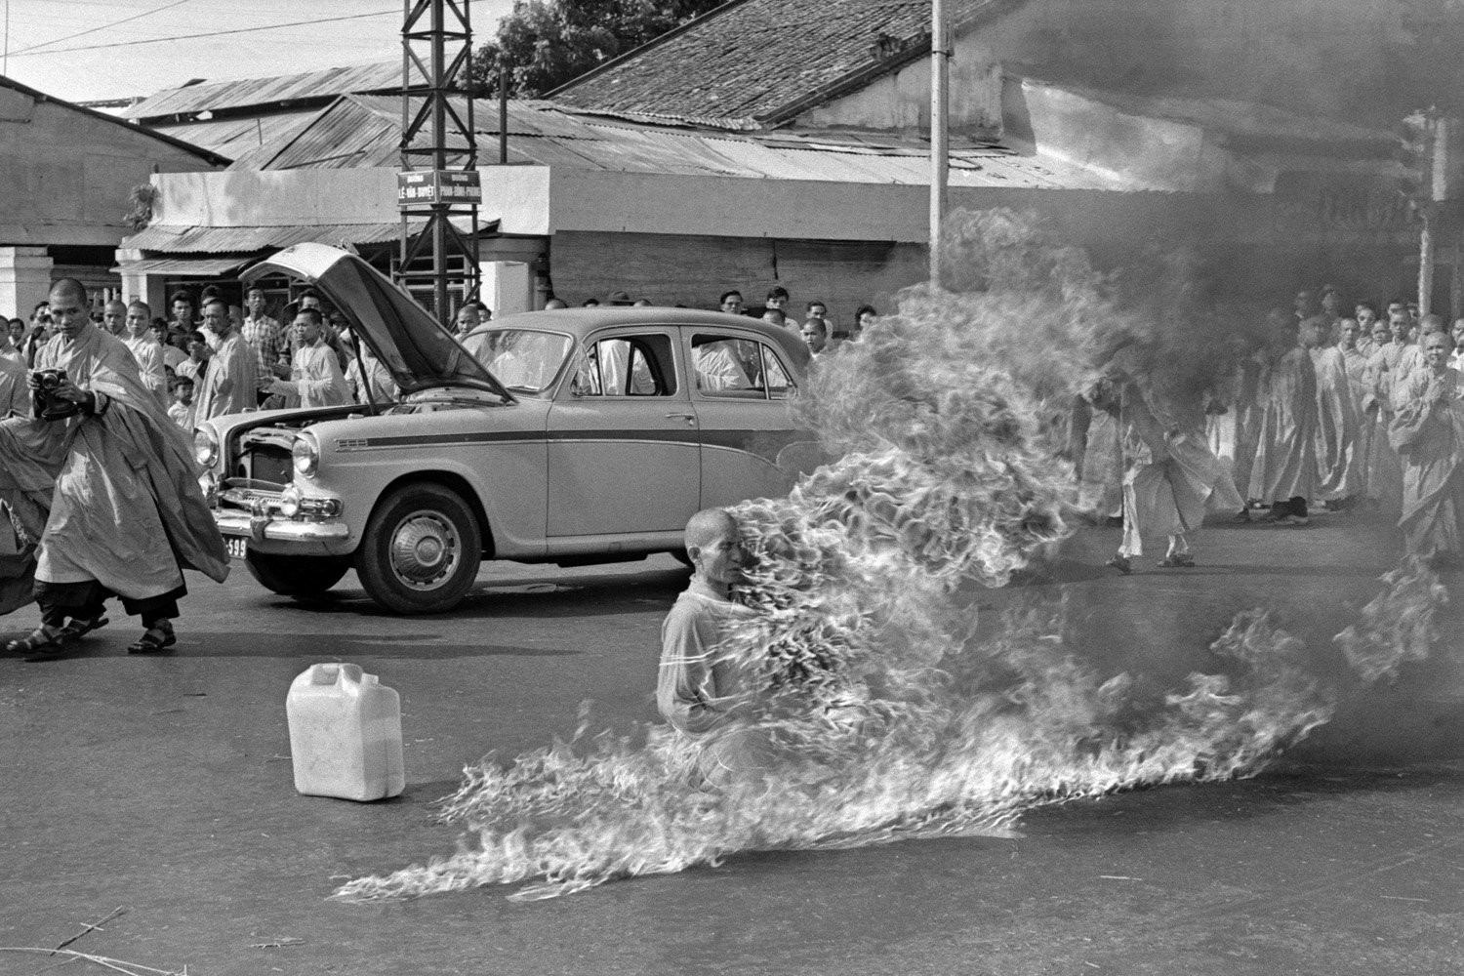

Slide 6
How does the author
On June 11, 1963, Thích Quảng Đức slowly burned himself to death.
Đức was a Vietnamese Monk, and the act was a form of protest motivated by the unequal treatment of the Buddhists by the South Vietnamese government of the country at the time.
While what went down that day came as a shock to everyone, the day before the event, there were actually whispers that something important was going to occur outside of the Cambodian embassy in Saigon, Vietnam. Most reporters ignored the message.
One of the people who didn’t, however, was David Halberstam. He was a journalist for the New York Times, and he watched it all go down.
He later recounted,
“I was too shocked to cry, too confused to take notes or ask questions, too bewildered to even think … As he burned he never moved a muscle, never uttered a sound, his outward composure in sharp contrast to the wailing people around him.”
The picture of Đức on fire is one of the most famous photographs in history. It captured the whole world’s attention at the time, and in the months following more protests were carried out. Eventually, the leaders of the South Vietnamese government were overthrown.

Slide 7
‘The author has created a sense of admiration for the monk.’ How far do you agree with this statement?
On June 11, 1963, Thích Quảng Đức slowly burned himself to death.
Đức was a Vietnamese Monk, and the act was a form of protest motivated by the unequal treatment of the Buddhists by the South Vietnamese government of the country at the time.
While what went down that day came as a shock to everyone, the day before the event, there were actually whispers that something important was going to occur outside of the Cambodian embassy in Saigon, Vietnam. Most reporters ignored the message.
One of the people who didn’t, however, was David Halberstam. He was a journalist for the New York Times, and he watched it all go down.
He later recounted,
“I was too shocked to cry, too confused to take notes or ask questions, too bewildered to even think … As he burned he never moved a muscle, never uttered a sound, his outward composure in sharp contrast to the wailing people around him.”
The picture of Đức on fire is one of the most famous photographs in history. It captured the whole world’s attention at the time, and in the months following more protests were carried out. Eventually, the leaders of the South Vietnamese government were overthrown.

Slide 8
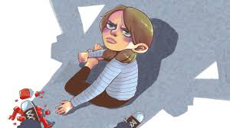
Write the next 2 minutes of this scene in great detail.
200 words= 20 minutes
Provoke, Dissuade, Dismay, Nauseous, Indignation, Resentment, Perplexed, Barbaric

