Slide 1
Language building 4

Slide 2
Homophones homo = same phones = sound
Some students struggle with these homophones: weather (the conditioning of the air), whether (a connective introducing an alternative)
Identify the errors in this passage. There are 3.
I’m not sure weather the weather is going to be sunny today. It often depends on whether the sun is out or not. Whatever the whether, I think we should go out and see the concert.

Slide 3
Rearrange into the right order
Once all the flour is incorporated, beat until you have a smooth, thick paste.
Crack the eggs into the middle, then pour in about 50ml milk and 1 tbsp oil.
Put the flour and a pinch of salt into a large mixing bowl and make a well in the centre.
Start whisking from the centre, gradually drawing the flour into the eggs, milk and oil.

Slide 4
Rearrange into the right order
It definitely takes some practice, since most of us are in the habit of taking quick, shallow breaths instead of long, deep ones.
Let the air completely fill your lungs.
Deep breathing will help you be more mindful of your body. Feel the air enter your lungs and fill them up. When you're concentrating on taking a deep breath, your worries are pushed aside for the time being.
Take a slow, deep breath in through your nose.
Focus on breathing in as much as you can through your nose, which has tiny hairs that filter out dust and toxins so they can't reach your lungs.^{[1]}

Slide 5
Past tense
Most times, when you discuss an action that happened in the past, you simply add ‘ed’ to the word. But there are some exceptions.
Which of the words below are in the past tense?
Jumped
Stretched
Missed
Mist
Went
Hazard
Jeopardized
Ostracized
Legitimate
Travel

Slide 6
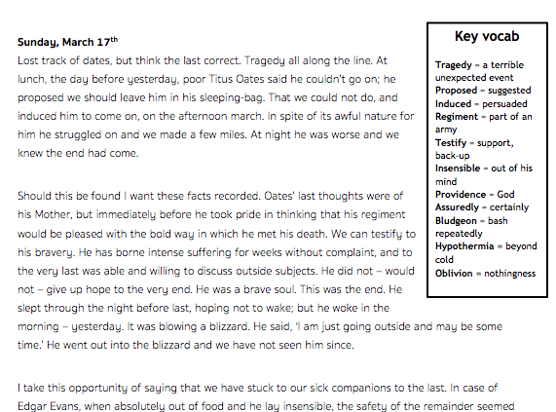
Comprehension - building analytical skills
Notes:
Students practice comprehension askills by answering questions based on the text. This is a strengthening exercise before we move onto exam style responses.

Slide 7
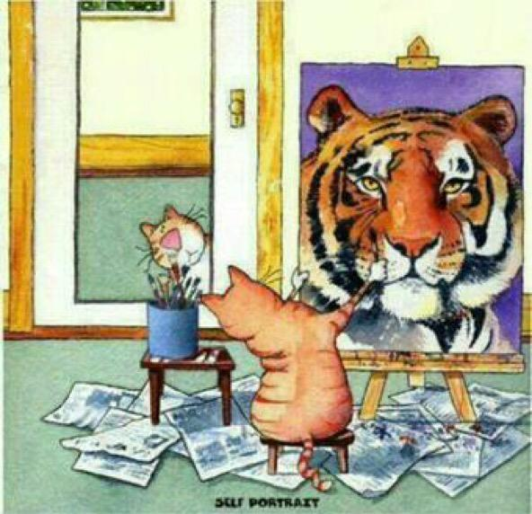
Write a letter to yourself to be read in 10 years from now. What do you want to achieve,, and how will you get there?

Slide 8
Recap
Did you use any of the new vocab in your letter?

