Slide 1
The origins of our words
ETYMOLOGY

Slide 2
A BIG JIGSAW
To begin with, there were some 300 or so words in the first language. But people wanted to communicate more than what was on offer, so they decided to add extra things onto these words.
The original words are called the ROOT words, or STEM words, and the additions to these words are called
AFFIXES
There are 2 common types of affixes: PREFIXES and SUFFIXES

Slide 3
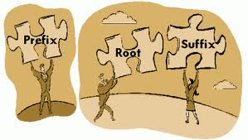
Suffixes are added at the end of a word – e.g. – ful, able, s, ing, ancy, ant, ary, ment.
Prefixes are added at the beginning of a word – e.g. – anti, un, non, dis, in, im.
ing
ant
ation
ed
In
Con
Per
form

Slide 4
What do these prefixes mean?
mis
spelt
understood
heard
informed
carriage
take
Mis =
Notes:
Mis = wrong

Slide 5
What do these prefixes mean?
dis
honest
inherit
heartened
figure
cover
interest
dis =
Notes:
Dis = opposite

Slide 6
What do these prefixes mean?
re
act
form
apply
take
present
submit
re =
Notes:
re = again

Slide 7
Spelling aid:
When prefixes are added they never change the spelling of a word…..

Slide 8
Spelling aid:
When prefixes are added they never change the spelling of a word…..
So if you know what the prefix is, you just stick it before the normal spelling of the word

Slide 9
Spelling - When prefixes are added they never change the spelling of a word…..
Which word is spelt correctly?
side A side B
1. missunderstood misunderstood
2. disshonest dishonest
3. preeview preview
4. unnatural unatural
5. immpossible impossible
6. irregular iregular
7. inncomplete incomplete
8. improbable immprobable
9. empower emmpower
10. addmit admit
Notes:
Write out correct spelling in books

Slide 10
Per = thoroughly or through
vert = to turn: pervert = to turn thoroughly
form = shape: perform = to shape thoroughly
vasive = to spread: pervasive = to spread thoroughly
fect = form of to do/make perfect = to do something thoroughly
severe = harsh: persevere = going through harshness
per
form
severe
fect
vasive
vert
Notes:
Add new vocab to book

Slide 11
Ad = to or toward
ad
vocate
vertisement
vantage
verb
dict
Dict = to say, and to fix: addict = fixed to something
Ver = to see: advertise = to go towards seeing
Voc = voice: advocate = giving voice to something
Vantage = high point: advantage = toward a higher place

Slide 12
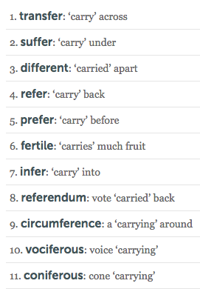
ROOT WORDS
12. Deference = respect – carried from
Notes:
When something is different, it is carried away or apart from the original.
Key terms to write: vociferous, infer, deference = to carry respect from

Slide 13
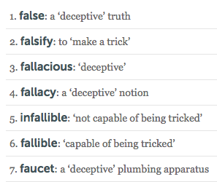
ROOT WORDS
Notes:
Fault – a derivative of fal – fault line (earthquakes), in tennis, ‘it’s not my fault’
Faucet – tricks you into thinking there is no water available – when the faucet is released, the water flows.
Pathetic fallacy - Human emotion given to something found in nature. A trick of the emotions: as in we perceive things in nature to be worse/better than they are when we are in an emotional state.
Key terms to write: fallacious, fallacy, infallible

Slide 14
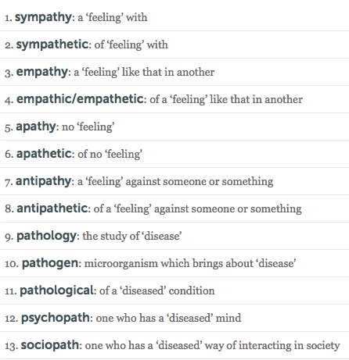
ROOT WORDS
Notes:
Pathetic fallacy - Human emotion given to something found in nature. A trick of the emotions: as in we perceive things in nature to be worse/better than they are when we are in an emotional state.
Key terms to write: antipathy, pathological, empathy

Slide 16
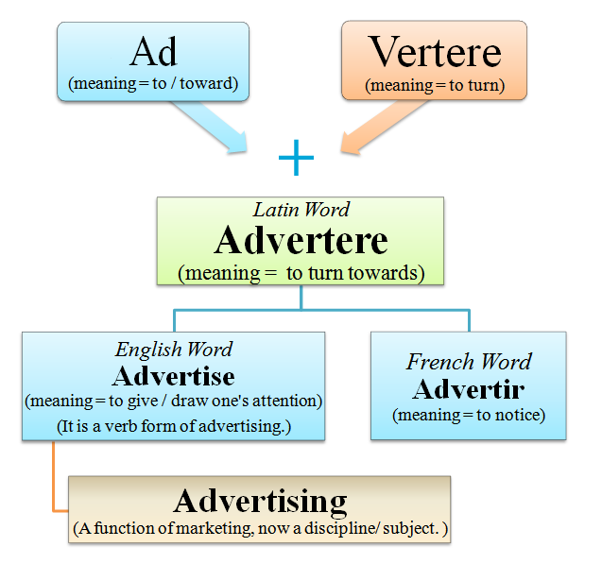

Slide 17
Minster
used in Britain in the name of a large or important church:
York Minster
Westminster,
Upminster,
Ilminster,
Newminster

